Slide 1
Ageing in the Middle East
By: Gabrielle Baker

Slide 2
The Issue of Ageing
Ageing populations are increasing at an alarming rate each year. Ageing becomes an issue when the median age of a country rises. This is either caused by a rising life expectancy or declining birth rate. Many countries across the globe are facing the struggle to support these demographic changes, which adds up quickly with the need for health care and social security costs.
The well-being of these elderly populations is also a concern, with many needing care because they are mentally/physically ill, or in some cases illiterate.

Slide 4
What’s Happening Now
As time goes on, the population of the Middle East and North Africa are rapidly changing. This presents a demographic challenge, as the region faces having to support more of the elderly with more health care.
It is expected that Egypt’s elderly population of over 60 years of age will increase from 4.3 million in 2000 to 23.7 million in 2050. Even more frightening, in Saudi Arabia, the elderly population will spike from 1 million in 2000 to 7.7 million by 2050.
A study by UNESCO was conducted in the Palestinian territory. After surveys were completed by elderly women of the population, results indicated that 60% were illiterate, 58.7% had cardiovascular problems, and only a mere 17.9% had social security. This is not good, considering the fact that 75% of the elderly women never had received paid work.

Slide 5
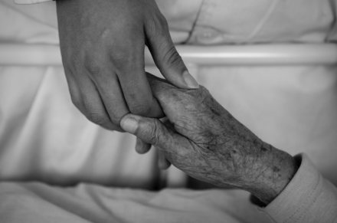

Slide 6
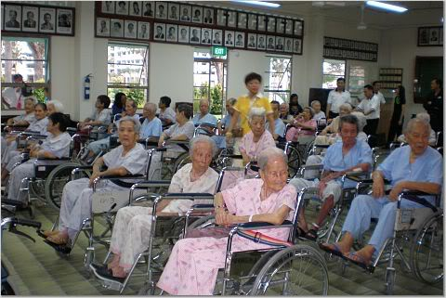
Nursing home in Japan

Slide 7
UN Involvement
As the UN studies and follows countries’ ageing populations (which are most prevalent in Europe and Asia), they have deemed 18 countries as “demographic outliers”.
In the entire human recorded history, the UN has observed that the aged population has never been so large as it currently is.
It is quite difficult to keep up with the issue, as each country has its own trends and pace of change.

Slide 8
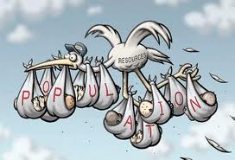

Slide 9
What is being Done?
The ratio for the young taking care of the old has now greatly increased.
With the global ageing population at an all time high, this presents many implications for every human on the planet. It will begin to be much harder to support everyone.
More services such as in-home health care and nursing have gained patients.

